Slide 1
MINI PROJECT - 02 PHOTOEDITOR (Pico)
Presented By: Presented To:
Ritik Gupta Ms. Ruchi Talwar
(191500659) (Technical Trainer)

Slide 2
OUTLINE
About the Android and Google Admob
About Project
Objective and use of this project
Requirements ( Software & Hardware)
Snapshots from this android application with their working descriptions
Conclusion
References

Slide 3
About the Android & Google AdMob
Android is a linux-based operating system designed primarily for touch screen devices such as smart phone tablets and computers. Released in 2008, is now owned by Google.
Android is a operating system like Windows, Ubuntu and Mac OS and a lot number of devices use Android these days like phones, watches and laptop.
An Android app is software running on a Android Platform. So this can be concluded that like all the software it is a combination of Backend and Frontend.
Backend to design the logical parts of the app, for the functionality whereas Front End to develop the User Interface.
So we also created an android application “Pico”, a library of photos. Play Store is a market place for all the Android Apps.
AdMob helps to monetize mobile app through in-app advertising. Ads can be displayed in a number of formats and are seamlessly added to platform native UI components.

Slide 4
About the Project
1. In this project, we are creating an android application, basically a PHOTOEDITOR App which we have named Pico. This application will provide us a platform to access the photos we want to edit at the ease of our fingertips.
2. All the users will be having their own photos on this app which will be save and share to various platforms like Facebook , WhatsApp , Instagram .
3. Any photo that the user wishes to edit will be entered by him from the file/gallery folder which works on the basis of users choice input. The photo may be of any thing, which the image is related and will also work on specific keywords input.
4. Apart from editing the photos , the user can save the photo he/she likes in the favourites folder. The app is suitable in the present scenario as the world is being digitalized then why not the photography system.
5. To get more details about the editing one can click on the image and get further editing features details.
6.This app will be using The Google Photos API for providing all the photos. Further the Google Ads adds all the necessary details that the user may need about the app. The app also has a complete User Interface with all exciting editing features

Slide 5
Objective of this Project
The main objective of this application is to create a PHOTOEDITOR app named “Pico” which will have a lot of images and a space to keep up the image one wants to edit. There will be a facility to search any image one wishes to edit by the use of any standard tool like the filters, frames, round, exposure, contrast, vignette, saturation, warmth, pixelate, draw, sticker and text.
Android Application – PHOTOEDITOR (Pico) 2 After the editing there will be list of related share/upload options like Facebook, WhatsApp and Instagram and one can view and like more about the details of the image and can further share it.

Slide 6
Use of this Project Many qualities of a photo can be manipulated using photo editing editor (Pico) software application, often on the pixel level. most basic photo editing software programs can accomplish a number of these techniques, including:- 1. Color Balance, which adjusts the levels of intensity across the color spectrum. 2. Exposure, which adjusts how much brightness or light is applied to the photo. 3. Noise/grain, which indicates the level of detail or distortion between pixels. 4. Saturation, which indicates the dramatic appearance of all colors. 5. Cropping, which adjusts the dimension of the image. 6. Burning/dodging, which adjusts the contrast between lightness and darkness. More advanced programs enable users to also perform operations such as background removal, healing, cloning, selective adjustments, and layering. These advanced programs often feature additional functionalities like brush and pencil stokes, textures, stickers and 3D design.

Slide 7
Requirements
Software Specification Used:-
• Technology Implemented :- ANDROID STUDIO
• Language used :- JAVA
• Other Technology Implemented are :- Google Admob

Slide 8
Hardware Specification Used:- • Processor used :- Intel i5 • Operating System used :- Windows 8/10/11 • RAM used :- 8GB • Hardware device :- Computer System • Hard disk :- 1TB • Display Screen :- Laptop Screen

Slide 9
THIS IS HOW OUR APPLICATION LOOKS
Hope you will like it :)

Slide 10
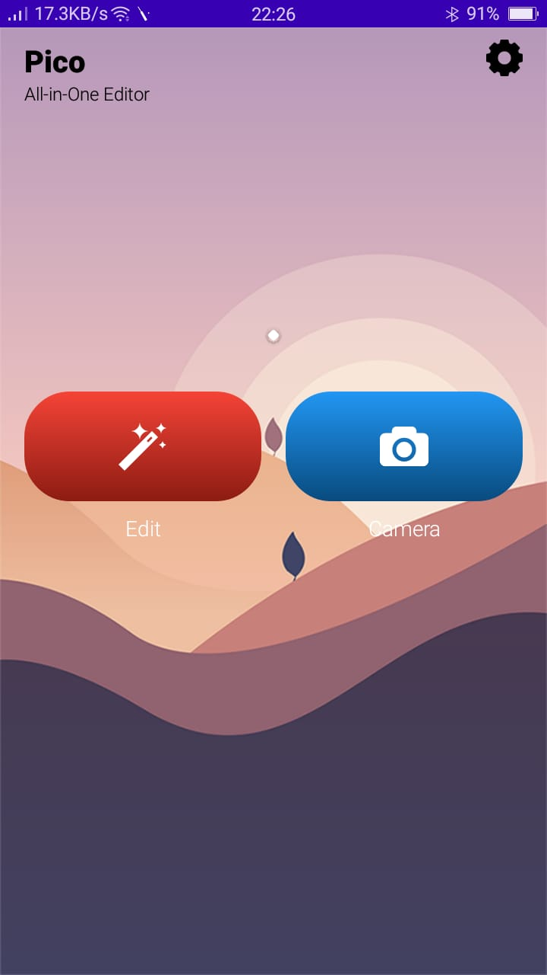
Splash Screen -> Should display splash screen with animated setting icon.

Slide 11
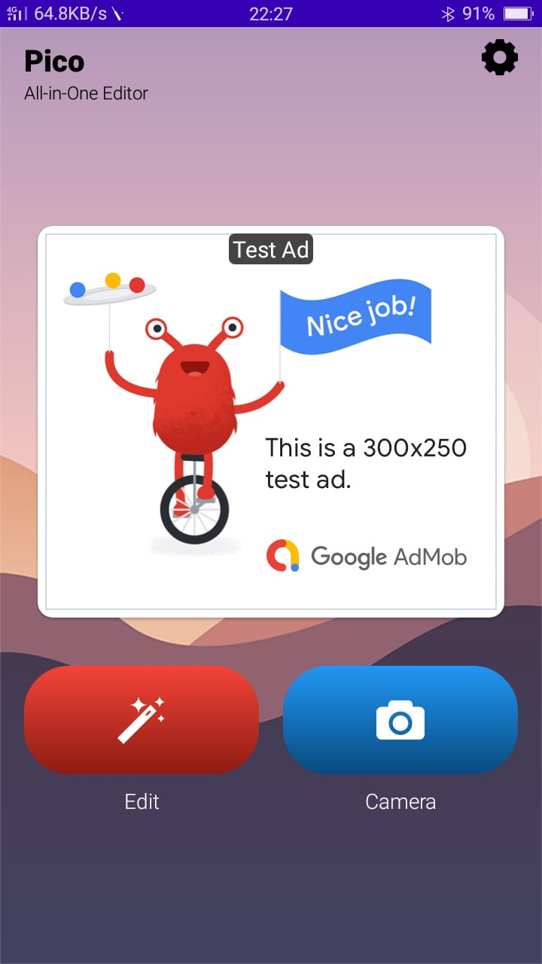
2. Dashboard with Google AdMob Screen -> Should display google admob activity where you also find edit and camera buttons

Slide 12
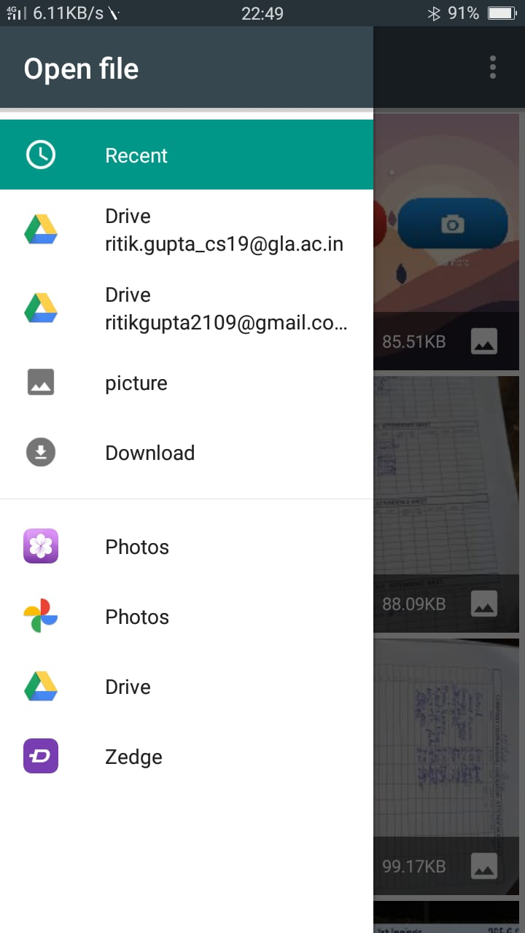
3. Navigating and selecting images -> Should display the dashboard of selecting an image from device.

Slide 13
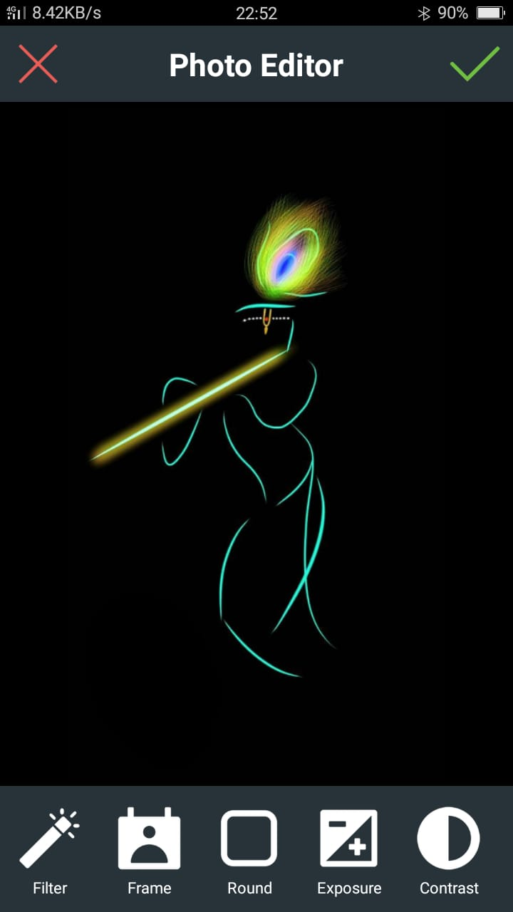
4.1. Editing Screen (a) -> Editing features (a) :- filter, frame, round, exposure, contrast.

Slide 14
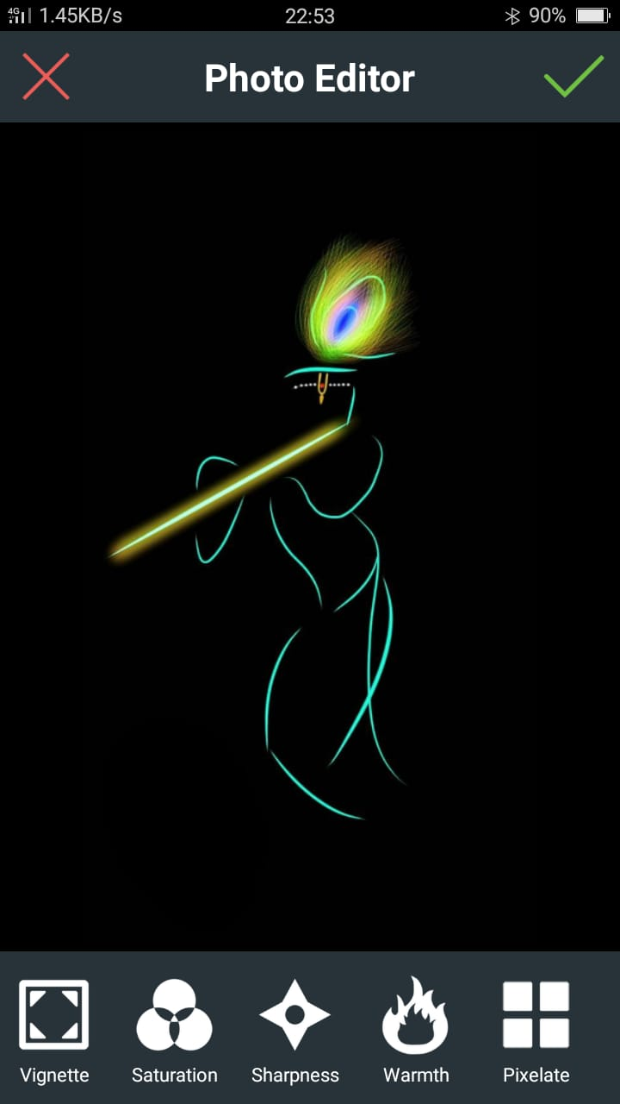
4.2. Editing Screen (b) -> Editing features (b) :- vignette, saturation, sharpness, warmth, pixelate.

Slide 15
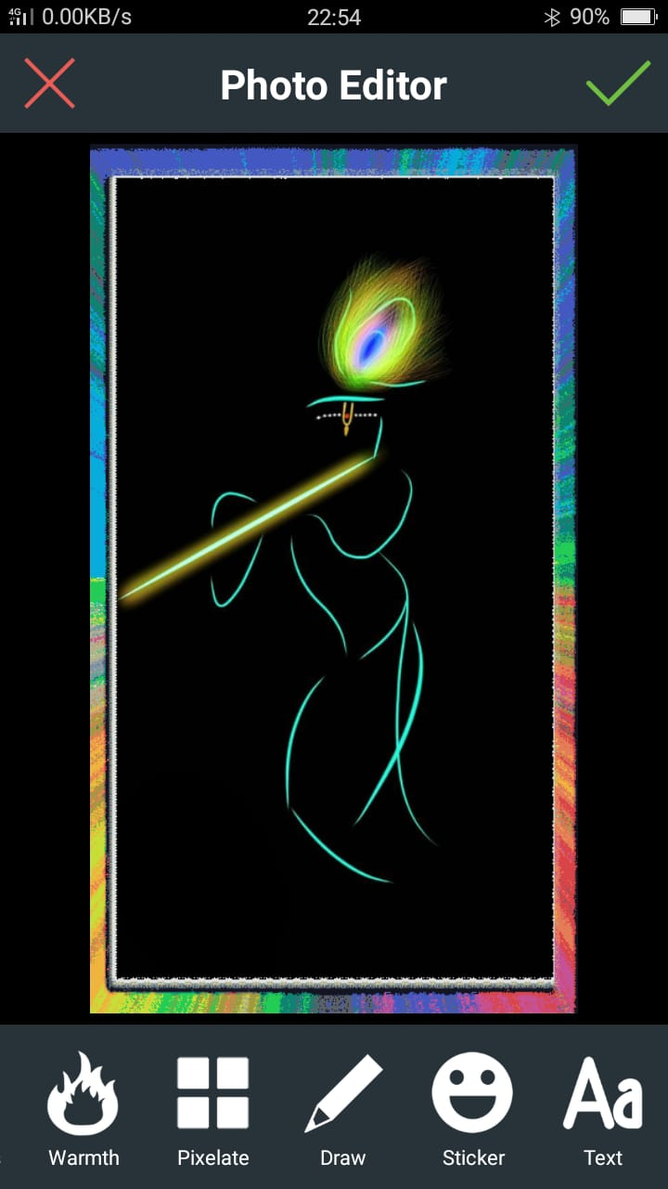
4.3. Editing Screen (c) -> Editing features (c) :- warmth,pixelate, draw, sticker, text.

Slide 16
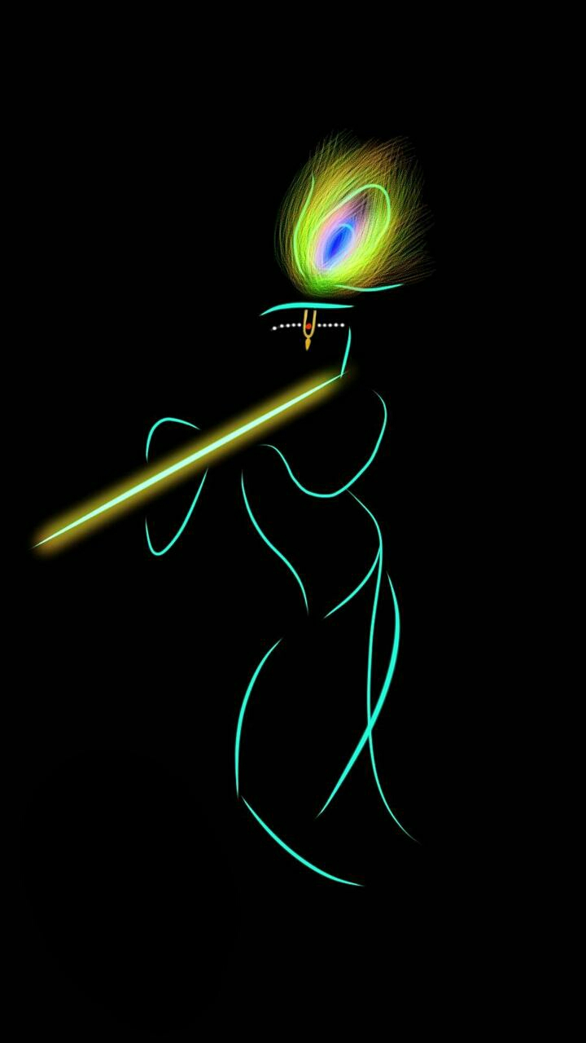
5. Saving image -> Should saved image in the device after editing.

Slide 17
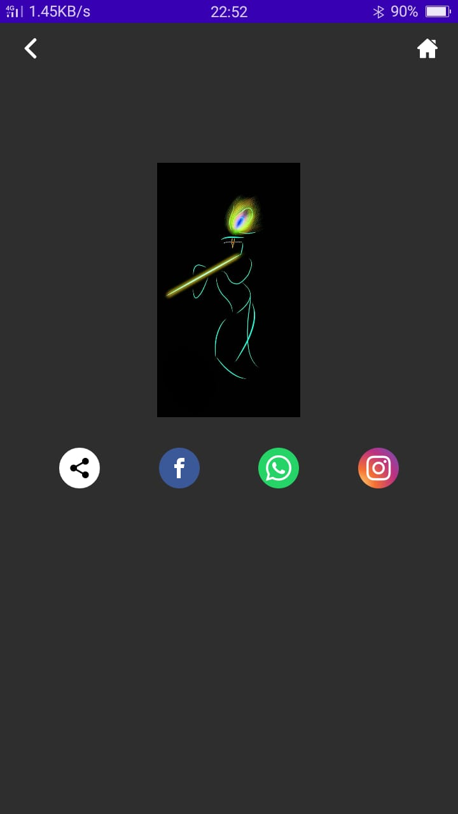
6. Share image on various platforms -> Should share edited image on various platforms like facebook, whatsapp, instagram.

Slide 18
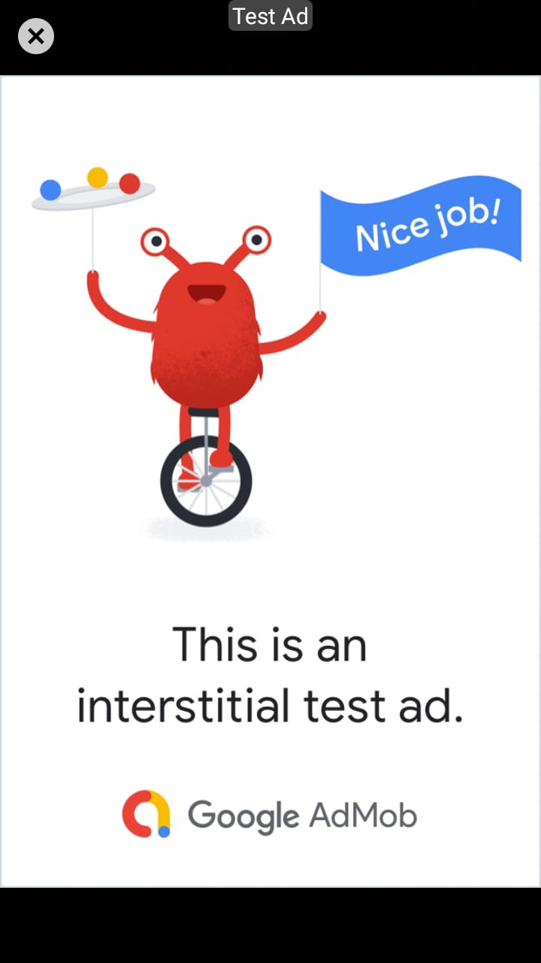
7. Intertitial Testing Ads -> Should display test from from Google AdMob

Slide 19
Conclusion -> Proposed Pico App is an android application that will allow users to search for photos to edit. This application takes in a user input and searches the Google Photos and Google Admob API with the user input and gets a list of images on the device based on the users search query. Search result screen will contain a list of image with following details: After editing user can save or share on social – media platforms . Users can also add the photos to the favourites folders. ->In e-commerce industry, photos are prime factors that are responsible for attracting customers. Here, a single photo can convey more details to a customer than a long product description. ->This is also same for real estate, fashion etc. Therefore, by using the potential of image editing , a lot of businesses are attracting a large number of customers and generating more revenue.

Slide 20
References 1. Introduction to Android: http://developer.android.com/guide/index.html. 2. Android API: http://developer.android.com/reference/packages.html 3. Android User Interfaces: http://developer.android.com/guide/topics/ui/index.html 4. Layout: http://developer.android.com/guide/topics/ui/declaringlayout.html 5. Android Training: http://developer.android.com/training/index.html. 6. Android developer Guide: https://developer.android.com/ 7. For rectifying the error : https://stackoverflow.com

Slide 21
Thank You!!!

